Slide 1

Forecasting Fertilizer Efficiency and Agricultural Productivity in East Africa
Optimizing agricultural growth through smart data-driven fertilizer strategies
Capstone Project | 2025

Slide 2
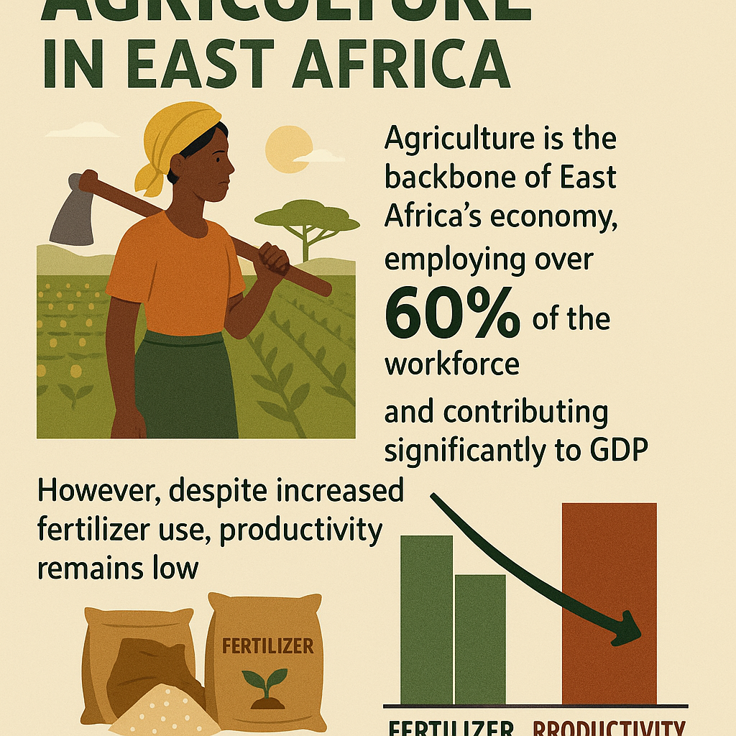
.

Slide 3
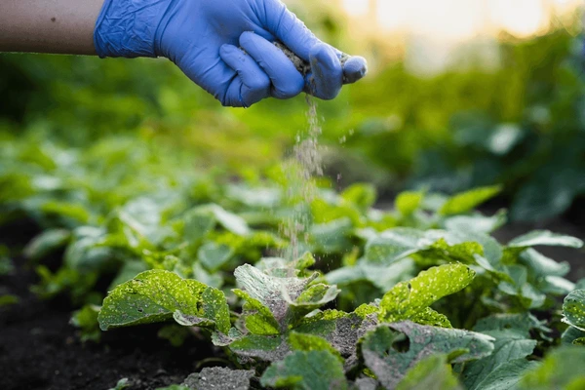
Business Understanding
Main Objective:
To analyze and forecast fertilizer efficiency and its impact on agricultural productivity using data-driven methods.
Specific Objectives:
Track fertilizer usage trends across East Africa over time
Examine the relationship between fertilizer use and agricultural output
Forecast fertilizer consumption up to 2035 using time series models
Predict agricultural productivity using machine learning techniques
Group countries based on fertilizer efficiency for targeted policy strategies

Slide 4
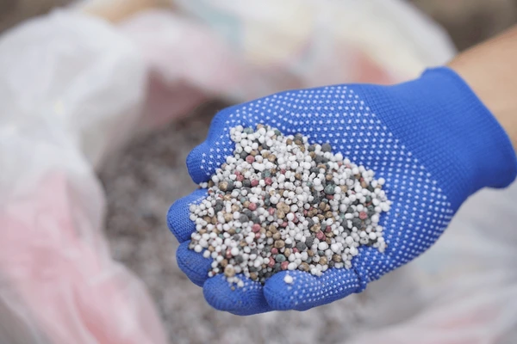
Data Understanding
Data Sources:
FAO
National Statistics
Key Observation:
Data spans 15 East African countries (1960–2023).
Includes metrics like cereal production, forest area, employment in agriculture.
Challenges: Missing data, inconsistent trends.
Key Indicators:
Fertilizer consumption (kg/ha)
Ag. value added (US$)
Employment in ag. (%)
Crop production index
World Bank Indicators

Slide 5
Data Preparation
Combined datasets from 15 countries into a unified dataset.
Cleaned redundant rows and standardized column names.
Checked for missing values and inconsistencies.

Slide 6
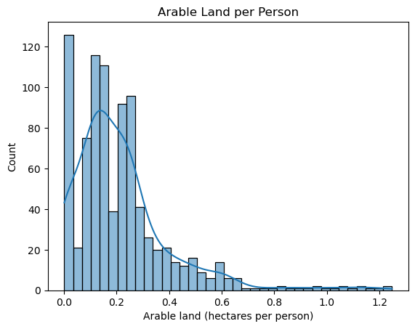
The majority of countries have very limited arable land available per person, with most falling below 0.3 hectares per individual.
This indicates high population pressure on arable land in many regions, especially in more densely populated countries.
FERTILIZER CONSUMPTION DISTRIBUTION

Slide 7
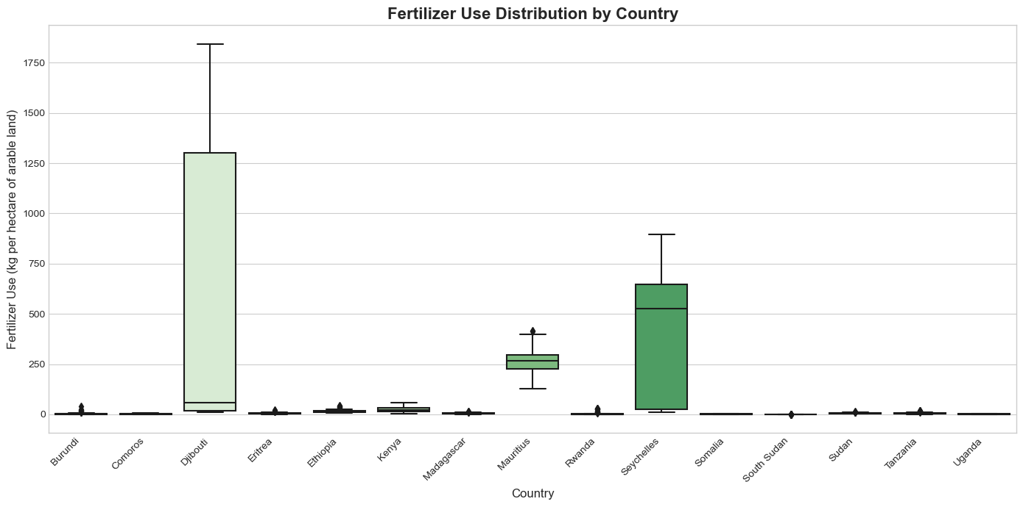
Djibouti and Seychelles have the highest fertilizer use, with Djibouti showing extreme variability.
Mauritius and Rwanda also have relatively high and consistent usage, suggesting well-developed agricultural practices.
The majority of countries show very low fertilizer use with minimal variation, indicating low input agriculture.

Slide 8

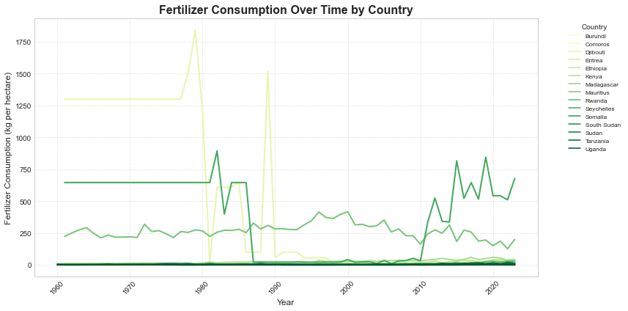
Fertilizer Consumption Trends Over Time
Some countries show a steady increase, indicating efforts to boost agricultural productivity.

Slide 9
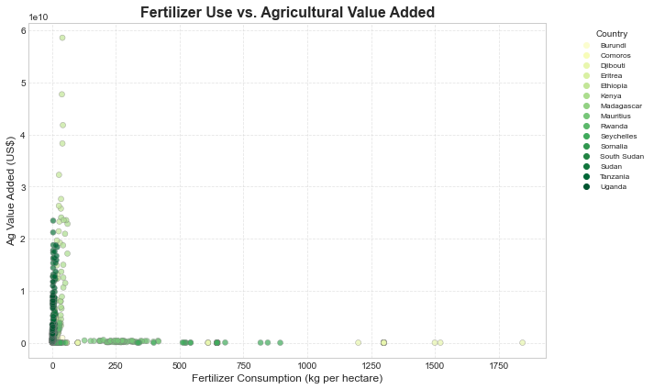
Fertilizer Use vs. Agricultural Value Added
Ethiopia demonstrates high output despite low fertilizer use
Mauritius shows extremely high fertilizer use but modest output

Slide 10
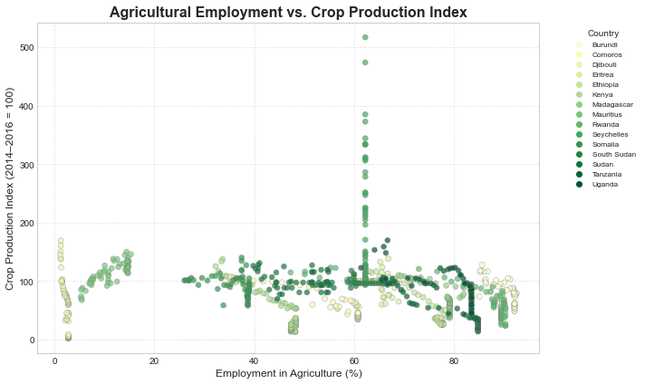
Agricultural Employment vs. Crop Production Index
Countries with lower ag employment often show higher crop index values (e.g. Kenya)

Slide 11
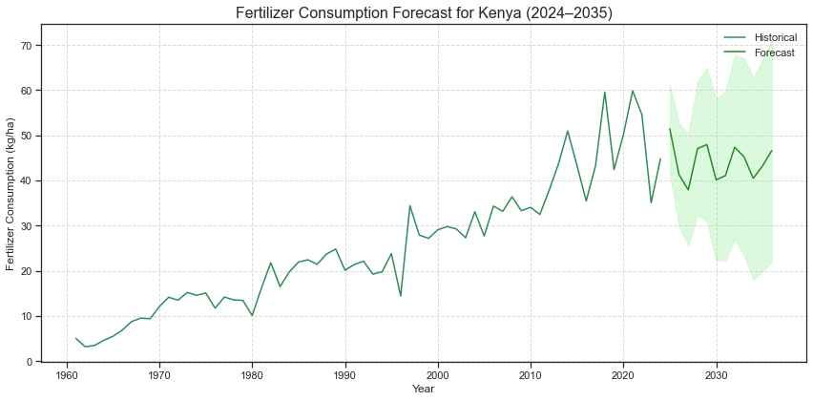
Fertilizer Consumption Trends and Forecast for Kenya (1960–2035)
Fertilizer use in Kenya rose steadily from 1960 to 2023.
The ARIMA model forecasts stabilization around 40–45 kg/ha through 2035.
Wide confidence intervals signal uncertainty thus external factors like climate, prices, and policy could impact actual outcomes.

Slide 12
MODELING APPROACH
Clustering (K-Means): Group countries by efficiency patterns.
Machine Learning (Random Forest, XGBoost): Link fertilizer use to productivity.
Time-Series Forecasting (ARIMA, LSTM): Predict future fertilizer demand.

Slide 13
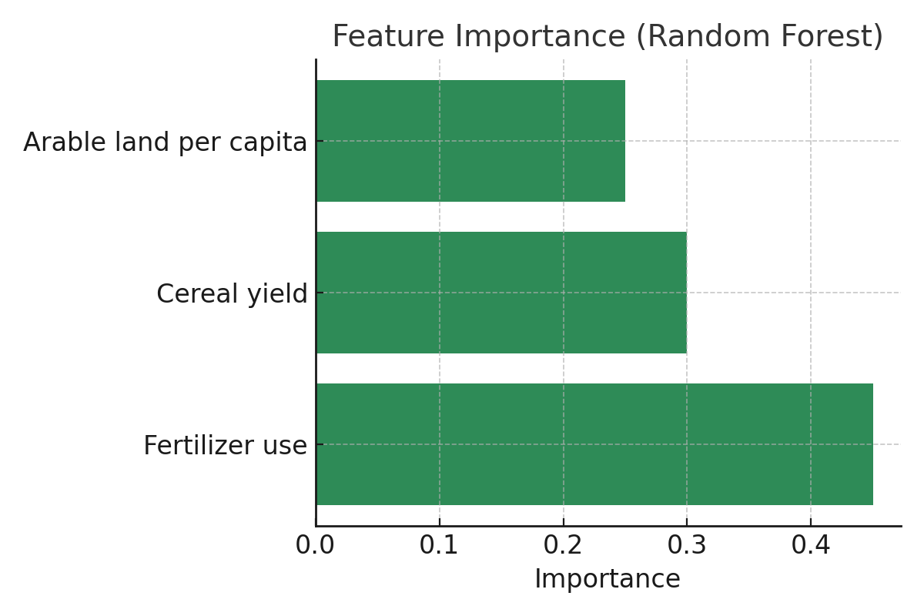
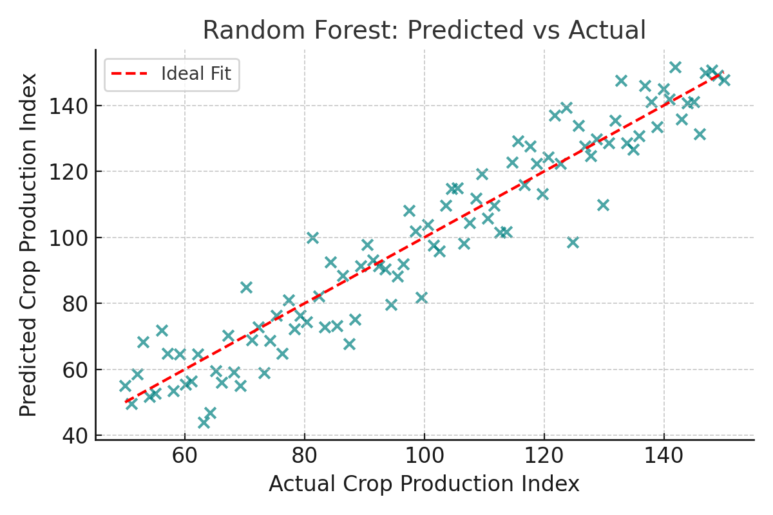
Best Performing Model- Random Forest
The tight clustering of data points around this line indicates high model accuracy and low prediction error.

Slide 14
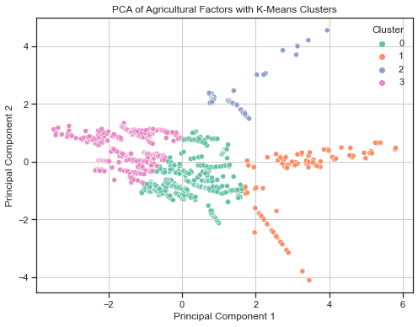
Segmenting Countries by Fertilizer Efficiency
Methodology:
Used K-Means clustering (k=4) based on fertilizer use and agricultural output, visualized using PCA (2D).

Slide 15
Policy Recommendations
Increase Fertilizer Access- Build supply chains and offer subsidies to make fertilizers affordable.
Promote Sustainable Use- Train farmers on efficient, eco-friendly fertilizer practices.
Boost Cereal Yields- Invest in research, improved seeds, and irrigation.
Maximize Arable Land- Encourage crop rotation and soil conservation.
Educate Farmers- Expand extension services for modern farming knowledge.
Adopt Technology- Support precision farming, mobile tools, and AI solutions.
Build Resilience- Introduce crop insurance and emergency reserves.
Strengthen Data Systems- Improve regional data sharing and analytics.
Support PPPs- Collaborate across sectors to fund and scale solutions.

Slide 16
Conclusion
This project developed a forecasting and analytics framework for fertilizer use in East Africa.
Historical and predictive analyses revealed key trends, gaps, and optimization opportunities.
Machine learning and time-series models uncovered non-linear dynamics in productivity.
Country clustering enabled more targeted and relevant policy recommendations.
Integrated, data-driven strategies are essential for sustainable agriculture and food security in the region.

Slide 17





Who’s This For?

Slide 18
Thank You !
Presented By: Group 2
GitHub Repo: github.com/Rodgerdev/east-africa-fertilizer-project

